Slide 2
Tell Us About You… What do you hope to get out of tonight?

Slide 3
Circling back to 2/28
Identify your SMART Goal and your WHY
1
Physically write both down
2
Identify somebody you can share these with for accountability
3
Choose an action item to adhere to for the next 2 weeks.
4

Slide 4
Circling back to 2/28: Healthy Habit Options
Drink
Drink ½ your body weight in oz of water each day
Modify if necessary
Eat
Eat 3 servings of fruit/vegetables per day
Eat
Eat breakfast every day
Eat
Eat Protein at every meal
Perform
Perform at least 5 minutes of deliberate exercise per day
Cook or prepare
Personally cook or prepare at least 3 of your meals this week
Cut out
Cut out all naturally and/or artificially sweetened beverages
Allow
Allow yourself 8 hours of sleep time each night
Don’t add
Don’t add salt to any of your food

Slide 5
How many calories does YOUR body need per day to…
Maintain
Maintain your current weight
Lose
Lose weight
Gain
Gain Weights

Slide 6
Now Entering The…
“What gets measured gets managed”
- Peter Drucker

Slide 7
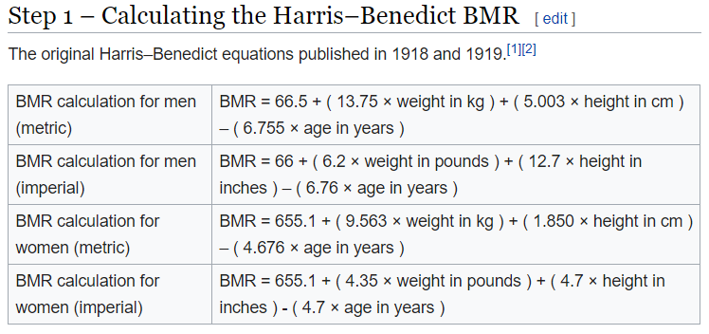
Basal Metabolic Rate
Defined As: the number of calories the human body burns per day simply to sustain vital functions such as breathing and keeping warm. (what you would burn if on bed rest)

Slide 8
BMR Factors that are taken into consideration:
Age
Current Weight
Height
Gender

Slide 9
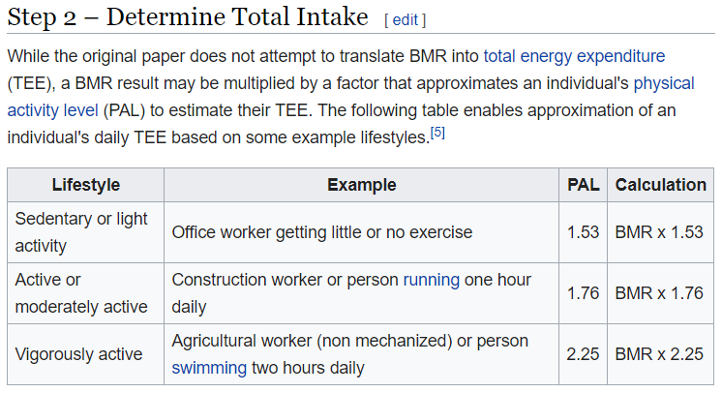
Total Daily Energy Expenditure (Break Even)
Defined As: the total number of calories you burn each day. (BMR + Activity = TDEE)

Slide 10
Defining Your Activity Level
Low Activity
You get little to no exercise
Light Activity
You exercise lightly 1-3 days per week
Moderate Activity
You exercise moderately 3-5 days per week
High Activity
You exercise heavily 6-7 days per week
Very High Activity
You exercise very heavily (i.e. 2x per day, extra heavy workouts)

Slide 11
Let’s calculate your TDEE
Here’s what we need to know:
AGE
Weight
Height (Feet & Inches)
Gender
Activity Level (Reference previous slide)

Slide 12
Once we have this number, what do we do with it?
Put the Equations to the Test:
To ensure you have accurately determined your TDEE, it’s always a good practice to start eating to this target calorie number while monitoring your weight. In theory, your weight should not change.
If your weight goes up, your TDEE is less than calculated and should be adjusted accordingly.
May need metabolic rehabilitation
If your weight goes down, your TDEE is higher than calculated and should be adjusted accordingly.

Slide 13
Once we have this number, what do we do with it? - Continued
To Maintain Your Weight:
Your average daily calorie intake should mirror your TDEE

Slide 14
Once we have this number, what do we do with it? - Continued
To Gain Weight :
In simple terms you should eat MORE than your TDEE
Range (100-500 excess calories daily beyond TDEE)
In the absence of a strength training program you can expect the majority of your weight gain to consist of adipose tissue or bodyfat.
In conjunction with a strength training program a natural man can expect to gain .25 - .5 pounds of muscle per week or 1-2 pounds per month.
In conjunction with a strength training program a natural woman can expect to gain .12 - .25 pounds of muscle per week or .5 – 1 pond per month.

Slide 15
Once we have this number, what do we do with it? - Continued
To Lose Weight :
In simple terms you should eat LESS than your TDEE
By eating 500 fewer calories per day than your TDEE you can expect to lose 1lb per week.
By eating 1000 fewer calories per day than your TDEE you can expect to lose 2 lbs per week.
By eating 1,250 fewer calories per day than your TDEE you can expect to lose 2.5 lbs per week.
It is not recommended that one should lose more than 2.5 lbs per week.
To minimize the loss of lean tissue, do this in conjunction with strength training and sufficient protein present in the diet.

Slide 16
Coming up next time… Thursday 3/29 @ 6PM
Topic: How to leverage technology to effectively and conveniently hit these new found goals.

Slide 17
Questions???

