Slide 1
The Effect Exercise Has On Your Weight

Slide 2
Whether we’re wanting to gain weight, lose weight, or stay the same… Step one is identifying your “Break Even” calorie mark which is your BMR + Activity Level.
Notes:
Identify if temporary or permeant

Slide 3
“BREAK EVEN” FACTORS INCLUDE: AGE WEIGHT HEIGHT GENDER ACTIVITY LEVEL
Notes:
Identify if temporary or permeant

Slide 4
NAME: JULIO AGE: 55 WEIGHT: 300 HEIGHT: 6” GENDER: MALE ACTIVITY LEVEL: LOW APPROXIMATE CALORIES BURNED PER DAY: 2684
WEIGHT LOSS EXAMPLE
Notes:
Identify if temporary or permeant

Slide 5
Caloric Deficit
A caloric deficit is any shortage in the amount of calories consumed relative to the amount of calories required for maintenance of current body weight (Break Even).
A deficit can be created by reducing calories consumed. A deficit can also be created by increasing calories burned without a corresponding increase in consumption.
Notes:
Identify if temporary or permeant

Slide 6
How Many Calories Does 1 Lb. of Bodyfat Contain??
Answer: 3,500

Slide 7
If Julio wants to lose 1 Lb. of fat per week, what should his daily caloric deficit be?
Answer: 500

Slide 8
If Julio wants to eat to his “Break Even” AND lose 1 Lb. of weight per week through walking…how much time will he need to spend walking (2 mph) each day of the week?
Answer: 1 Hour

Slide 9
Which of these forms of exercise burns the most calories per hour?
Walking @ 3mph – 300 cals/hour
Hiking – 450 cals/hour
Bicycling – 575 cals/hour
Swimming – 600 cals/hour
Rowing – 800 cals/hour
Jump Rope – 1000 cals/hour
Calculations based off on 160 pound individual. For every 20 pounds of bodyweight +/- 20 calories

Slide 10
How many hours of each will the avg. person need to perform to burn 1Lb. Of Fat?
Walking @ 3mph – 300 cals/hour
11.6 Hours
Hiking – 450 cals/hour
7.77 Hours
Bicycling – 575 cals/hour
6 Hours
Swimming – 600 cals/hour
5.8 Hours
Rowing – 800 cals/hour
4.3 Hours
Jump Rope – 1000 cals/hour
3.5 Hours
Calculations based off on 160 pound individual. For every 20 pounds of bodyweight +/- 20 calories

Slide 11
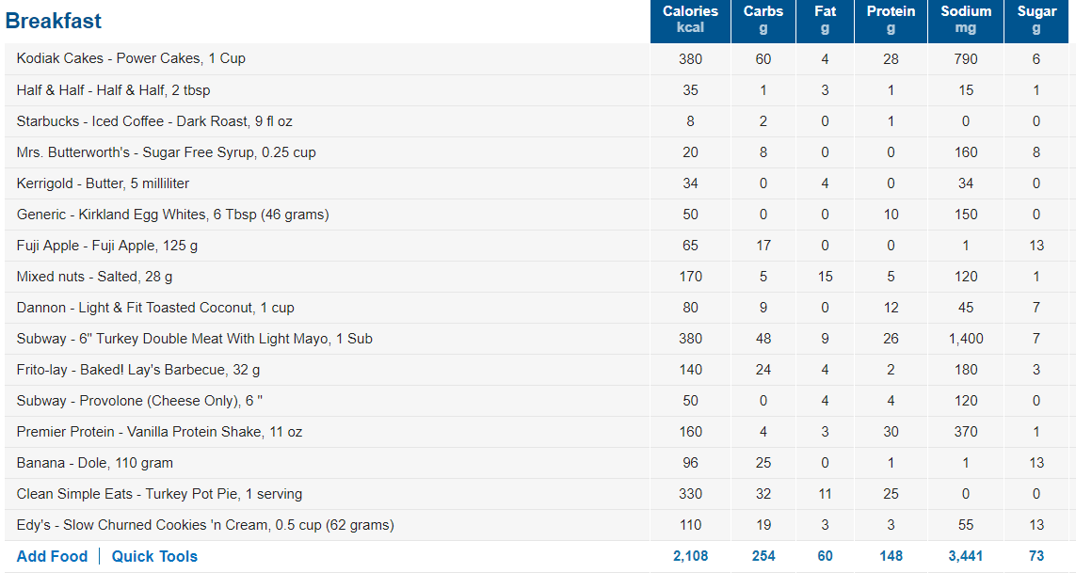
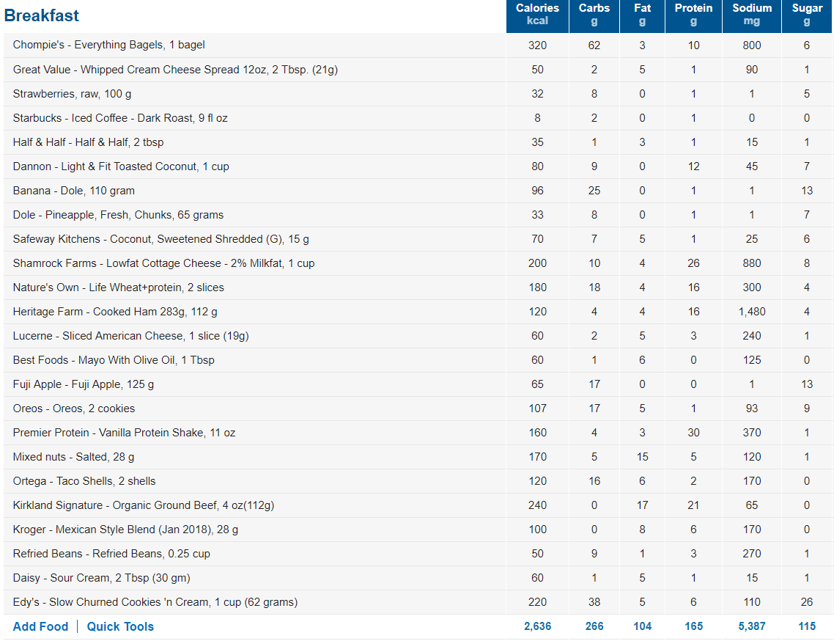
Eat this and don’t walk
Eat this and walk 60 min/day
Weight Loss Progress Will Be Equal In Both Scenarios

Slide 12
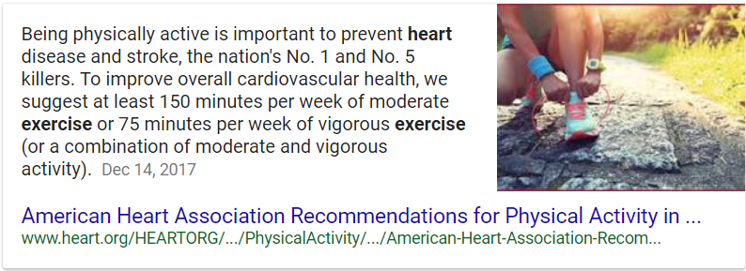
Chance are you recommending I don’t exercise??

Slide 13
Key Takeaways
If you’re in pain and unable to exercise, you’re not disqualified from weight-loss.
Weight loss is possible through achieving a caloric deficit through diet alone.
For maximal results and health benefits combine exercise with calorie control.
Do not exceed 2.5 lbs. of weight loss per week.
80/20 Rule: Weight Loss is 80% Diet and 20% Exercise

Slide 14
Questions & Answers

